Slide 1
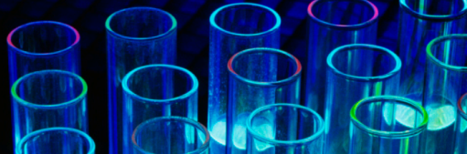
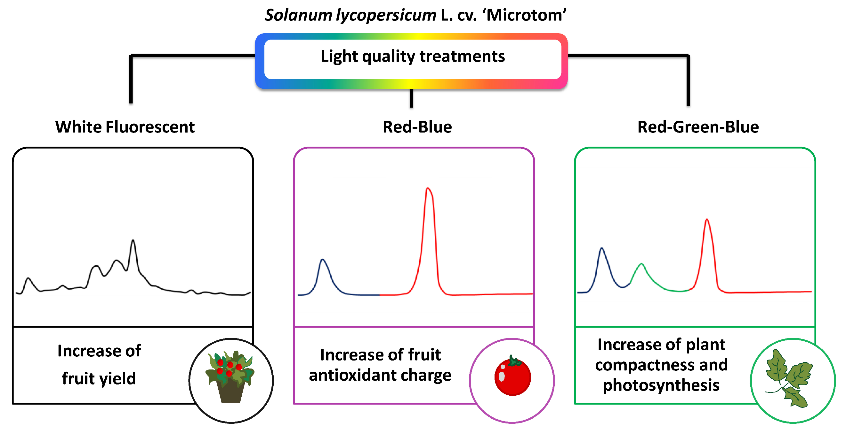
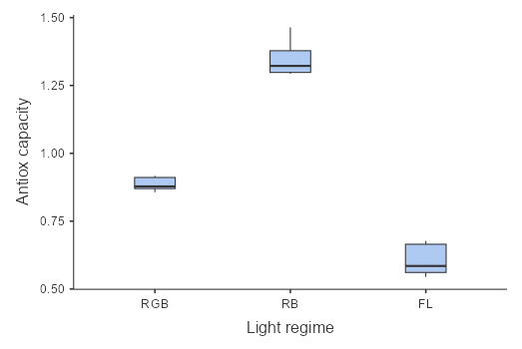
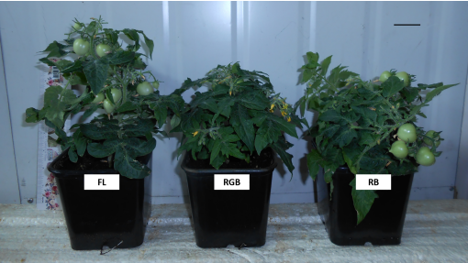
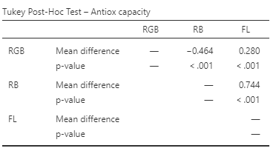
Manipulation of light quality to regulate the photosynthetic and antioxidant capacity of ‘Microtom’ plant : A full experiment
Name: BRUCE ODEK OMONDI / ID: 20074027 // Tutor: DR MARY KYNN // School: EECMS
Introduction
Methods
Results
The original study aimed to investigate how manipulating the light source during the growth of Microtom plants would influence their photosynthetic activity and fruit bioactive synthesis, and how this would improve the plants’ physical performance and the nutritional value of their fruits.
Micro-Tom, or Microtom, known scientifically as ‘Solanum lycopersicum’, is a smaller cultivar of tomatoes that is known for having a faster life cycle from germination to seed set. It is also more resistant to adverse weather conditions and can therefore survive in areas with such harsh conditions.
The study compared how 3 different light regimes, RB (red-blue light), RGB (red-green-blue light), and FL (white fluorescent light) have varying effects on the different characteristics of Microtom plants, i.e., the no.of fruits yielded and their antioxidant capacities, the leaf functional and physical traits, photosynthetic efficiency, and Rubisco and D1 protein expression, etc.
My study is a more simplified version of that analysis, which focuses on how manipulating the different light quality regimes affects the antioxidant capacity in Microtom yields.
This is because antioxidant properties of plants are particularly useful in helping the plants protect themselves against unstable molecules within them that can damage cells and affect their resistance to diseases, their growth, and subsequently, their crop production.
The higher the antioxidation capacity, the more resilient a plant is, and the more likely it is to survive in adverse conditions.
Some key experiment design features:
1. Replication – the 3 light regimes treatments are replicated on 5 plants per treatment, giving 15 total observations. This also helps to increase the reliability of our findings.
2. Randomisation – all plants are cultivated under the same constant conditions except the manipulation of the 3 light regimes. The experiment is set up simply as a standard randomized controlled trial, with only the 3 ligh regimes being randomly assigned to each random seed to avoid any biases.
3. Sampling – samples were collected from each fruit for each unit to measure the antioxidant capacity.
This study will help to understand how cultivating certain crops in a controlled environment with artificial light sources (i.e., the different light spectrums – RB, RGB, FL) can be beneficial for controlled agricultural production in harsh conditions.
Microtom seeds were sown in 3L pots and peat soil and set 10-15cm apart. These were then set under the 3 light regimes using LED diodes for RBG and RB light, and a fluorescent tube for FL light.
This treatment was replicated 5 times for each light regime, totaling 15 experiment units. These were each observed from time of sowing to the fruit ripening 100 days later. The experiment was set up in a climatized chamber where the following conditions were kept constant to avoid having any uncontrolled/unknown factors influencing the results:
1) photosynthetic photon flux density (PPFD) 300 ± 5 mmol photons m−2 s−1 [for each light treatment]
2) day/night air temperature 24/18 Celsius
3) relative air humidity 60–70%
4) photoperiod of 12 h.
5) irrigation at 2-day intervals
6) fertilized with Hoagland’s solution every 2 weeks
To measure the antioxidant capacity, 0.250g samples taken out of each fruit were treated with methanol/water solution and assessed by Ferric Reducing Antioxidant Power assay (FRAP). The samples were centrifuged at 20,817g force for 15 min at 4 degrees C, mixed with the FRAP reagents, and incubated in the dark for 1 hr., after which the absorbance amount was read, and the antioxidant capacity was calculated using a Trolox standard curve expressed as mmol Trolox equivalents (g-1 FW)
The antioxidant capacity recorded for each of the 5 units in each light treatment was recorded and using Jamovi, I conducted one-way ANOVA analysis on this data to assess the effect of the different light regimes on the antioxidant capacity. I also conducted post-hoc Tuckey analysis for more insight into the difference in effect for each light regime.
The dataset was readily available and well laid out with no need for further preparation techniques.
Results from Welch’s one-way ANOVA analysis of the antioxidant capacity for each light treatment showed that treating the experimental units to different light regimes had a statistically significant effect on the differences of means of the antioxidant capacity ( F=144, p <.001). Thus, we could reject the null hypothesis in favor of the alternative hypothesis.
To further compare the individual effects of each light treatment, I conducted post-hoc Tuckey analysis. The mean differences coincided with the original study to show that RB has the highest mean antioxidant capacity in comparison to the 3 light regimes and there is statistically significant differences in antioxidant capacity between all 3 light treatment groups (p <.001). Same can be seen in the boxplots to the left.
Normality was assumed (W=0.925, p=0.227) from Shapiro Wilk test and the Q-Q plot, which showed majority of the points scattered along the diagonal. The variance was also assumed to be homogenous (F=3.11, p=0.081)
Conclusion
Based on the results of this simplified version of the original study, it could be inferred that different light regimes (RB,RGB,FL light) do have different effects on the antioxidant capacity of Microtom and similar crops. The study reveals that Microtom seeds grown under RB light produce fruits with the highest antioxidant capacity as compared to those grown under RGB or FL lights, making them more resilient to harsh conditions, damage, or diseases.
This study extends our knowledge of artificial and controlled agricultural practice, leading to more efficient Microtom plant cultivation with specific light manipulation for plants with better resilience in arid areas, harsher climates, and can even be extended to use in interplanetary sustinence (space exploration).
While the data was easy to find and I was able to reproduce the analysis to get results similar to the original study, in future, larger sample sizes and focusing on continuous RB spectra data to see the optimal RB light range would be advisable for better reproducibility and reliability of findings, and to improve the ANOVA analysis.
Experiment setup
Works Cited
Vitale, E., Velikova, V., Tsonev, T., Constanzo, G., Paradiso, R., & Arena,C. (2022). Manipulation of Light Quality is an Effective Tool to Regulate Photosynthetic Capacity and Fruit Antioxidant Properties of Solanum Lycopersicum L. cv. ‘Microtom’ in a Controlled Environment. Plant Biology. https://doi.org/10.7717/peerj.13677

